Slide 1
CSci 3081W: Program Design and Development
Lecture 7 – Testing

Slide 2
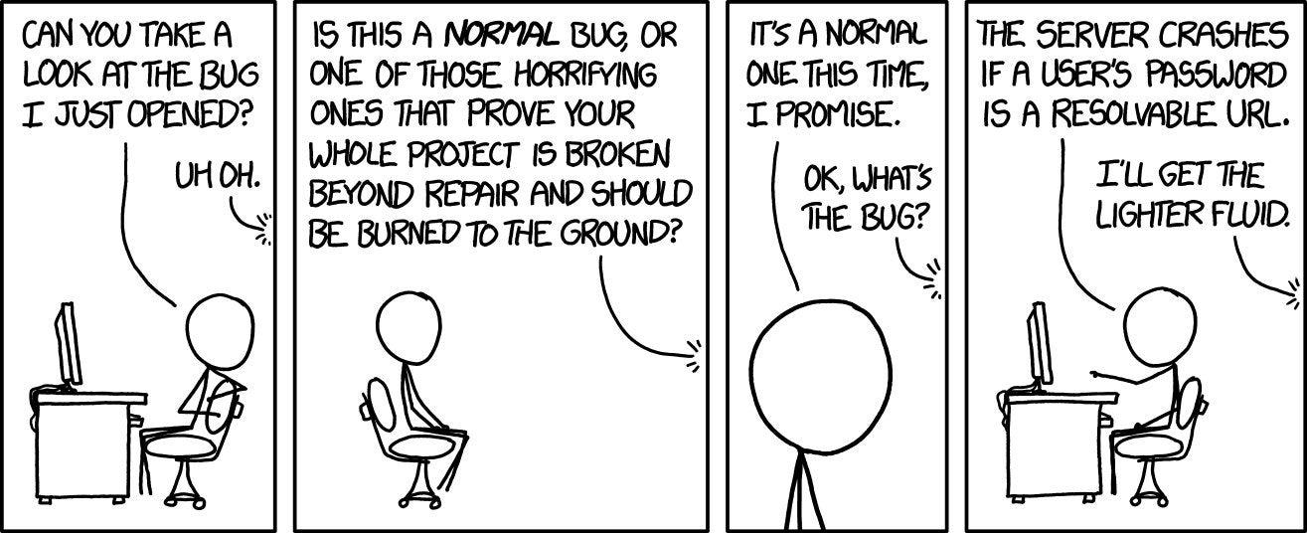
Testing
Program testing can be used to show the presence of bugs, but never their absence.
– Dijkstra, 1969

Slide 3
Testing
As the number of detected defects in a piece of software increases, the probability of the existence of more undetected defects also increases
Assign your best programmers to testing
Exhaustive testing is impossible
You cannot test a program completely
Even if you do find the last bug, you’ll never know it
It takes more time than you have to test less than you’d like
You will run out of time before you run out of test cases

Slide 4
Types of Testing
Different standards on types of testing
According to the optional textbook, there are five types of tests:
Unit Testing – testing a single class
Component Testing – testing a subsystem
Integration Testing – testing multiple classes
Regression Testing – testing that future changes don’t break the system
System Testing – testing the entire system including hardware performance, security, etc.

Slide 5
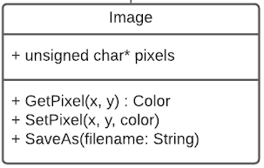
Unit Test
TEST_F(ImageTest, SavesImage) {
Image image(“input.png”);
image.SaveAs(“output.png”);
ASSERT_TRUE(fileExists(“output.png”));
}

Slide 6
Integration Test
TEST_F(ImageTest, ColorCorrect) {
Image image(“red.png”);
Color c = image.GetPixel(0,0);
EXPECT_FLOAT_EQ(c.Red(), 1.0)
}

Slide 7

Testing
Testing can be done at multiple levels of knowledge

Slide 8
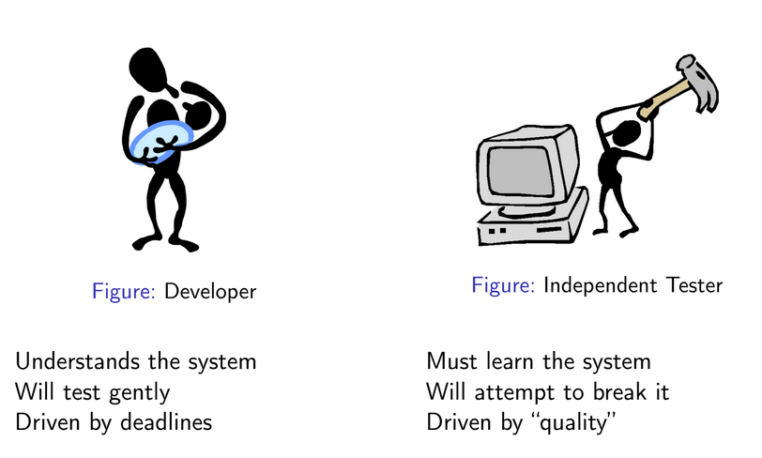
Testing

Slide 9
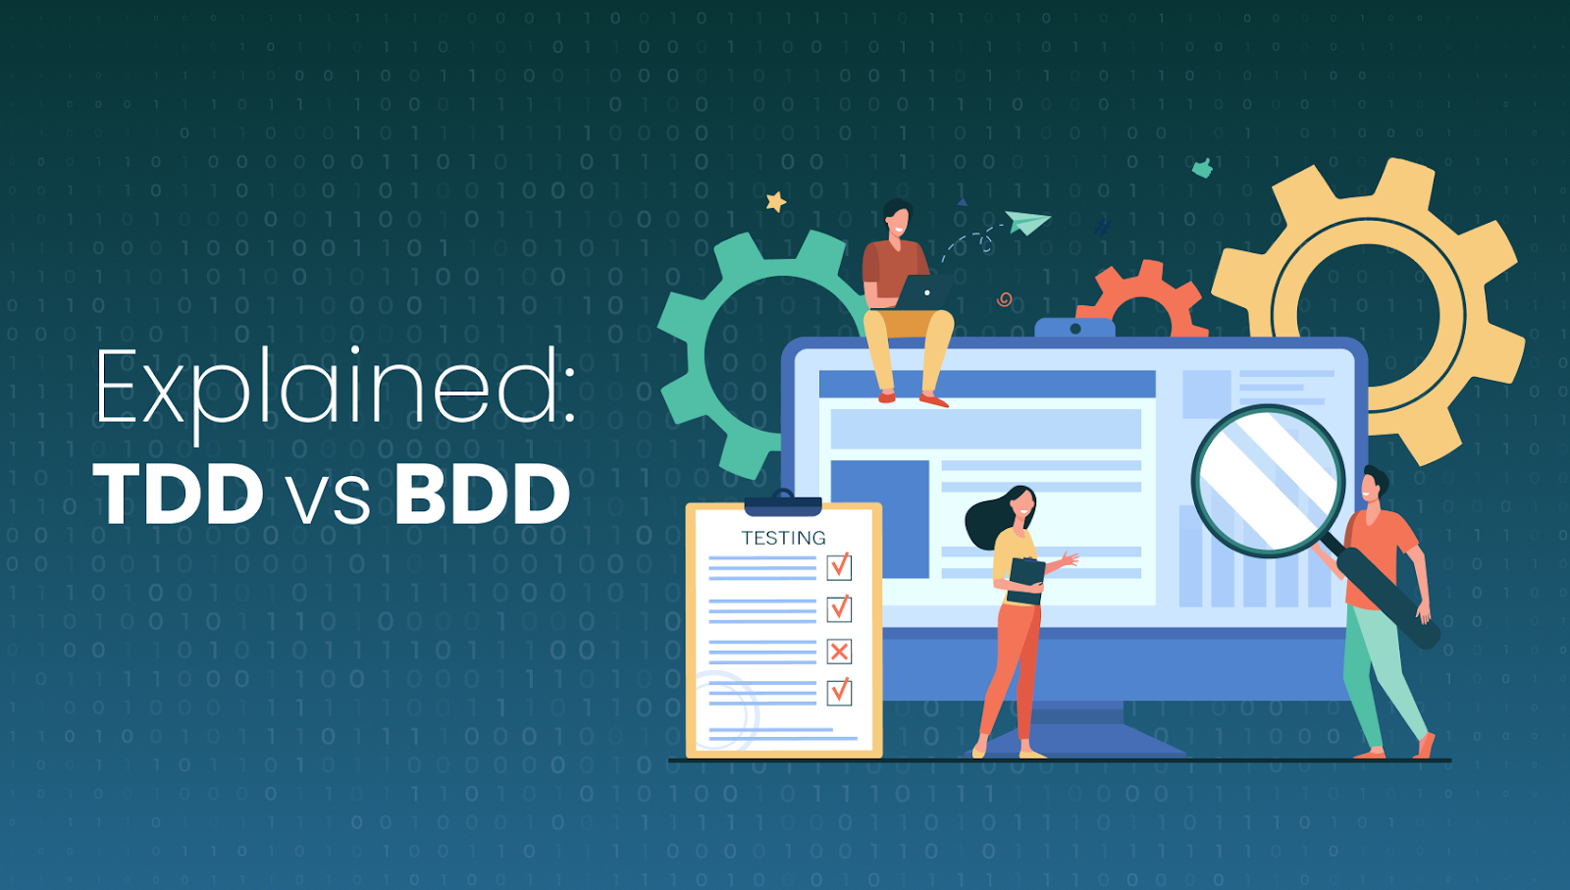



Quality Tests
Test Driven Development
Statistical & Boundary Analysis
Structured Basis Testing
Mutant Analysis

Slide 10
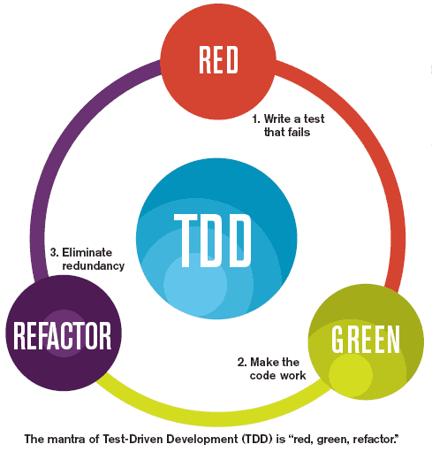
Test Driven Development (TDD)

Slide 11
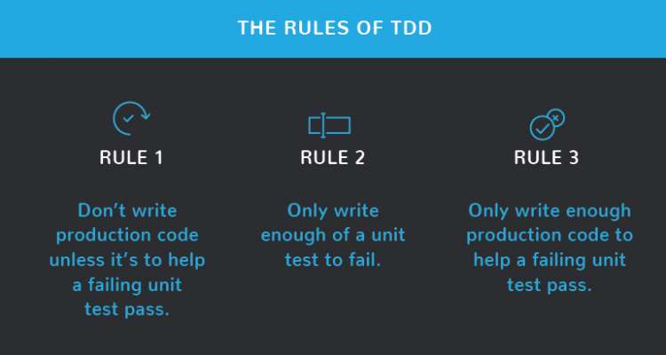
Test Driven Development (TDD)

Slide 12
Test Driven Development (TDD)
Beginner:
able to write a unit test prior to writing the corresponding code
able to write code sufficient to make a failing test pass

Slide 13
Test Driven Development (TDD)
Intermediate
practices “test driven bug fixing”: when a defect is found, writes a test exposing the defect before correction
able to decompose a compound program feature into a sequence of several unit tests to be written
knows and can name a number of tactics to guide the writing of tests (for instance “when testing a recursive algorithm, first write a test for the recursion terminating case”)
able to factor out reusable elements from existing unit tests, yielding situation-specific testing tools

Slide 14
Test Driven Development (TDD)
Advanced
able to formulate a “roadmap” of planned unit tests for a macroscopic features (and to revise it as necessary)
able to “test drive” a variety of design paradigms: object-oriented, functional, event-drive
able to “test drive” a variety of technical domains: computation, user interfaces, persistent data access…

Slide 15
Test Driven Development (TDD)
More info / further reading: Test Driven Development: By Example
By Kent Beck https://www.amazon.com/gp/product/0321146530/ref=as_li_ss_tl?ie=UTF8&linkCode=sl1&tag=&linkId=6d76ed79b7f498d7930b370ad4c059ac

Slide 16
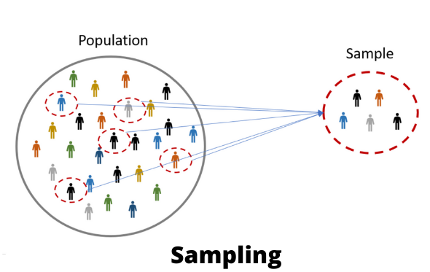
Statistical and Boundary Analysis
Test with good data and the test should pass

Slide 17
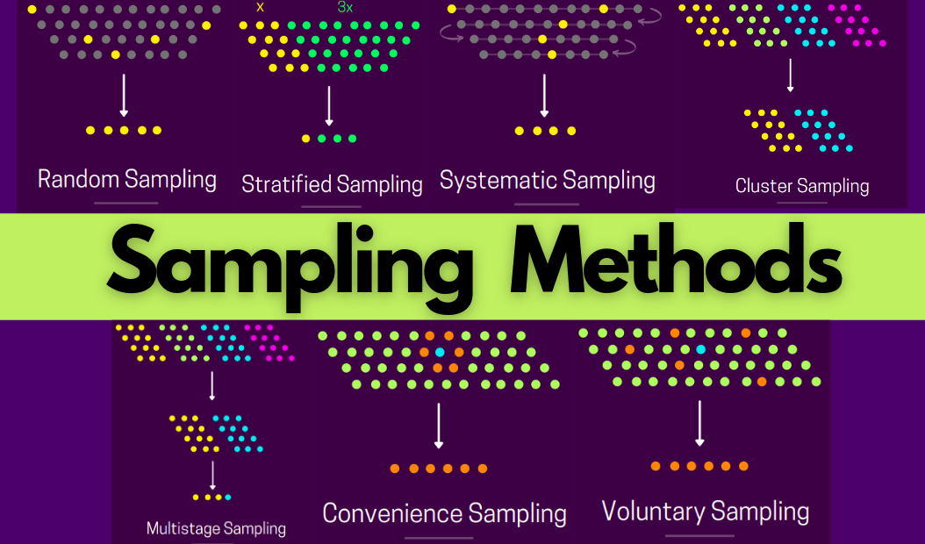
Sampling Methods

Slide 18
Boundary Analysis
Test edge cases and bad data
Edge Test Cases:
Value just above the maximum
Value equal to the maximum
Value just below the maximum
Bad Data Cases:
Incorrect format
Invalid pointer
Wrong type
Too little / too much data

Slide 19
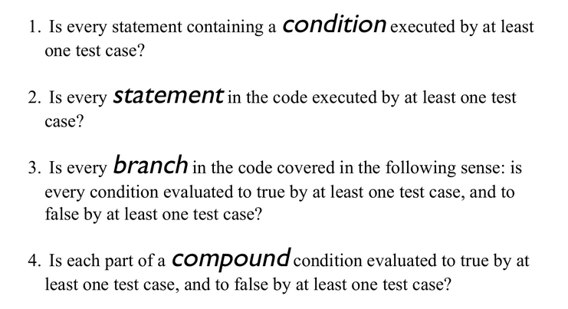
Structured Basis Testing

Slide 20
Structured Basis Testing
To find a minimal number of test cases to cover all possible values of each part of each condition in a piece of code:
Start with 1 for the straight path through the routine.
Add 1 for each of the following keywords (or their equivalents): if, while, repeat, for, and, and or.
Add 1 for each case in a case statement. If the case statement doesn’t have a default case, add 1 more.
Code Complete, McConnell, Ch. 22.3 (pp.505-509)

Slide 21
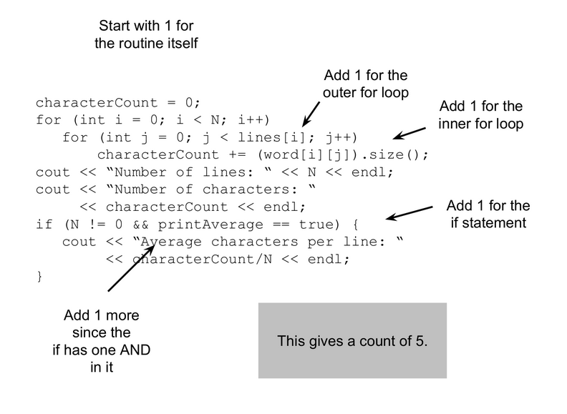
Structured Basis Testing

Slide 22
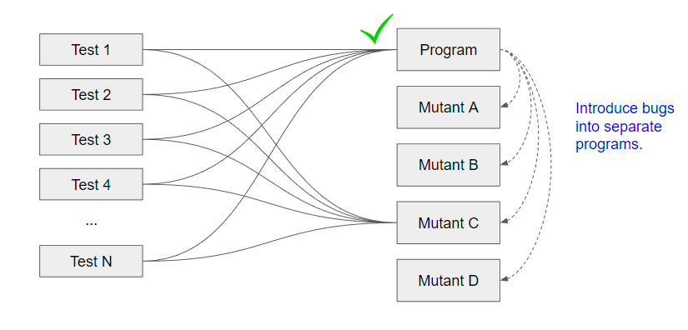
Mutant Analysis Testing (homework 3)
Process of creating many programs with small bugs

Slide 23

Mutant Analysis Testing (homework 3)
Process of creating many programs with small bugs
If all the tests pass, that is a bad thing

Slide 24
Other types of testing
Functional testing
End-to-end testing
Acceptance testing
Smoke testing
Atlassian’s CI/CD guide for software testing:
https://www.atlassian.com/continuous-delivery/software-testing/types-of-software-testing

Slide 25
Google C++ Testing Framework
Skim this: https://developer.ibm.com/articles/au-googletestingframework/
Additional reading on Mock Testing: http://google.github.io/googletest/gmock_for_dummies.html
https://site.mockito.org/ (open source - MIT license)

